Slide 1

Life Regression
C4V Track 2 (NGOs)
Bob D. Kang | Daniel Torres | Francesca Sposito | Justyna Dmowska | Esienam Agbenorto
2/16/2020

Slide 2
AGENDA
Cleaning process
Data quality issues
Target Audience
Dashboard

Slide 3
DATA CLEANING
Dropping irrelevant variables
Converting text to figures
Imputing missing values with “Unknown”
Changing “Unknown’s” to “0”
Aggregation by weeks

Slide 4
DATA QUALITY ISSUES
10 % MISSING VALUES
SOLUTION:
Incorporate category for ‘unknown’
Control inputs (radio buttons, checkboxes)
Standardize scales
DIFFERENT SCALES
NUMERICAL VS. TEXT INPUTS
SCARCITY AS THE ONLY CRITERIA TO EVALUATE NECESSITY OF MEDICINES, EQUIPMENT ETC.

Slide 5
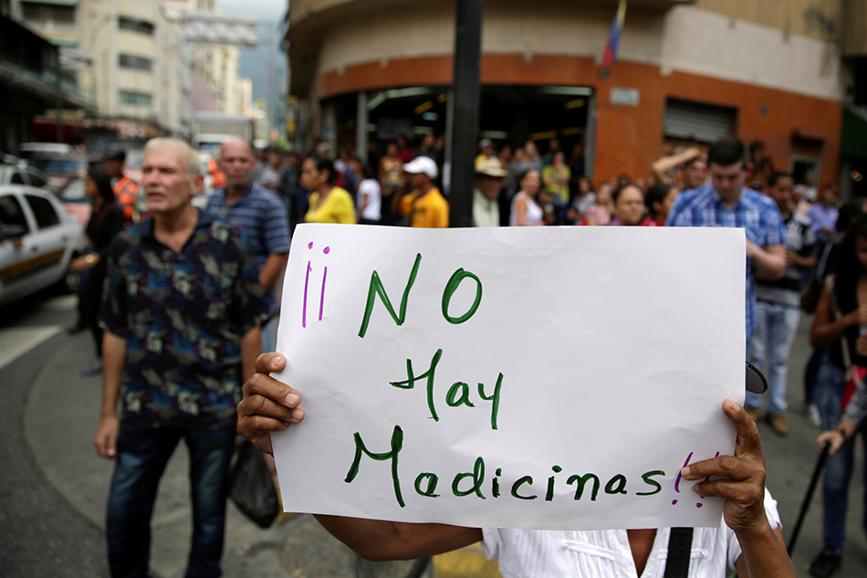
Target Audience
International NGOs
Providers of medicines and/or medical equipment
Want to know what is the most needed right now
Constraints
There is no capacity to produce in Venezuela
Information about scarcity of resources is limited
International NGOs cannot distribute directly to regions (everything goes through government)

Slide 6
OUR DASHBOARD

Slide 7
Thanks!
Any questions ?

Slide 8
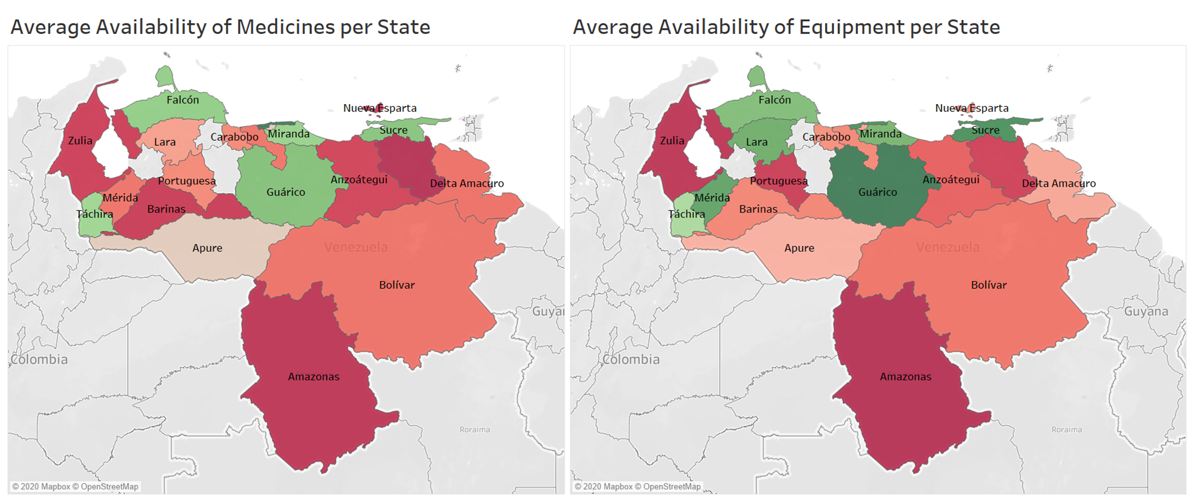
STATE LEVEL

